Slide 1

Natural Language Processing with Deep Learning
CS224N/Ling284
Christopher Manning and Richard Socher Lecture 2: Word Vectors

Slide 2
1. How do we represent the meaning of a word?
Definition: meaning (Webster dictionary)
the idea that is represented by a word, phrase, etc.
the idea that a person wants to express by using words, signs, etc.
the idea that is expressed in a work of writing, art, etc. Commonest linguistic way of thinking of meaning:
signifier ⟺ signified (idea or thing) = denotation

Slide 3
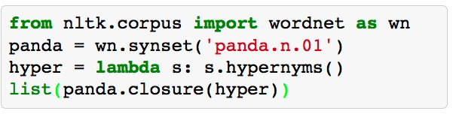
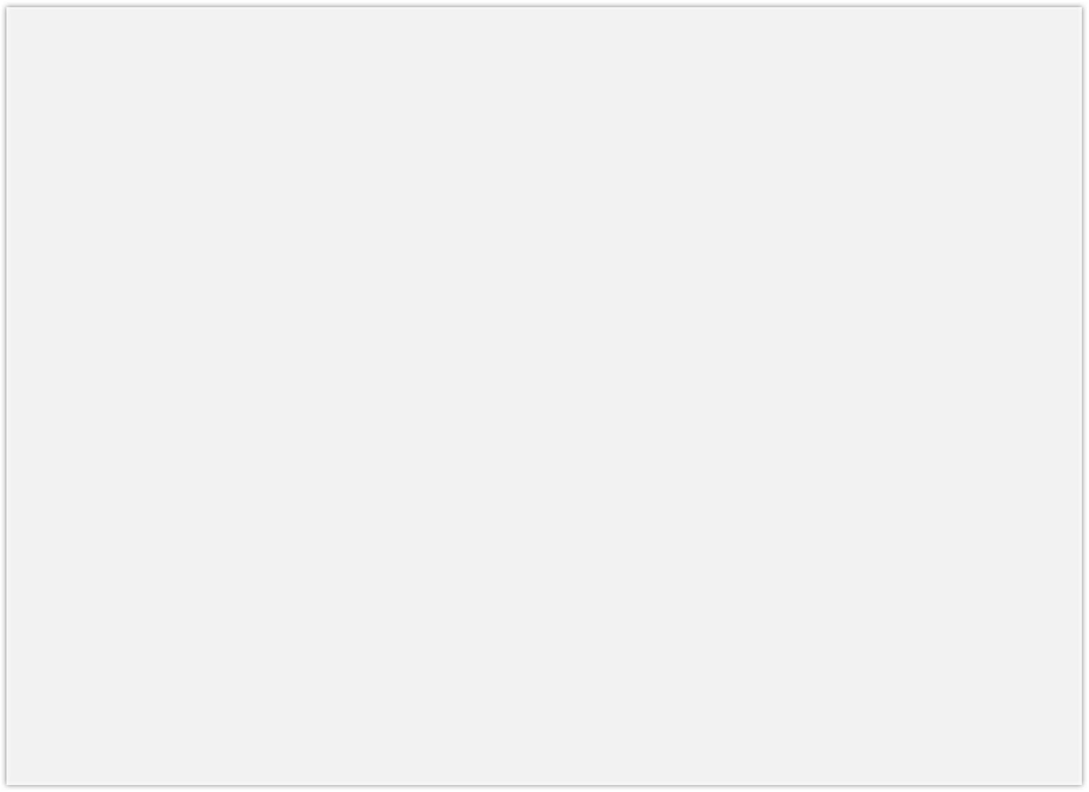
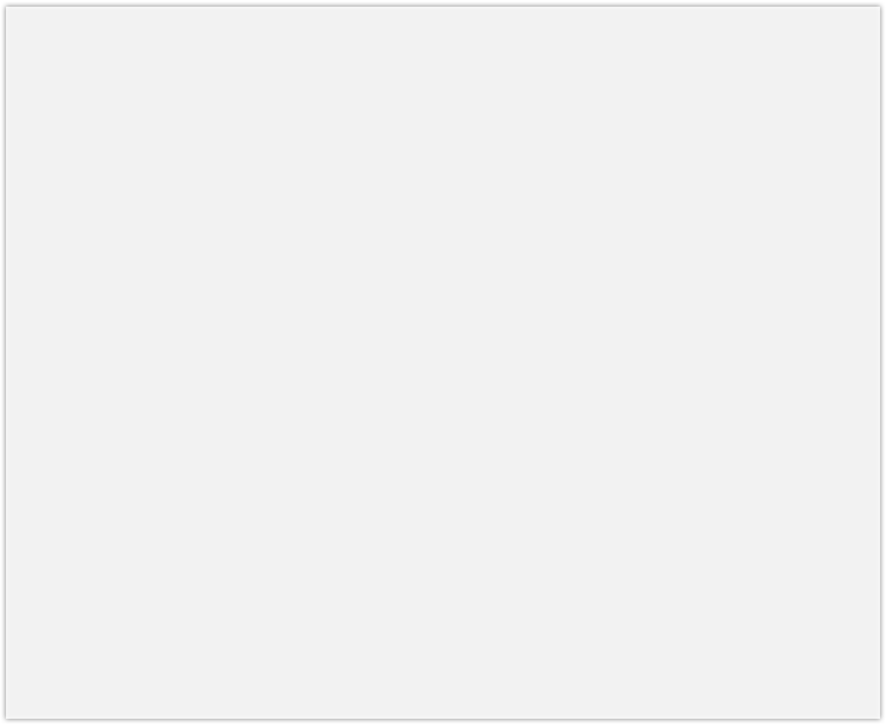
How do we have usable meaning in a computer?
Common answer: Use a taxonomy like WordNet that has hypernyms (is-a) relationships and synonym sets
(here, for good):
S: (adj) full, good
S: (adj) estimable, good, honorable, respectable S: (adj) beneficial, good
S: (adj) good, just, upright
S: (adj) adept, expert, good, practiced, proficient, skillful
S: (adj) dear, good, near S: (adj) good, right, ripe
…
S: (adv) well, good
S: (adv) thoroughly, soundly, good S: (n) good, goodness
S: (n) commodity, trade good, good
[Synset('procyonid.n.01'), Synset('carnivore.n.01'), Synset('placental.n.01'), Synset('mammal.n.01'), Synset('vertebrate.n.01'), Synset('chordate.n.01'), Synset('animal.n.01'), Synset('organism.n.01'), Synset('living_thing.n.01'), Synset('whole.n.02'),
Synset('object.n.01'), Synset('physical_entity.n.01'), Synset('entity.n.01')]

Slide 4
Problems with this discrete representation
Great as a resource but missing nuances, e.g.,
synonyms:
adept, expert, good, practiced, proficient, skillful?
Missing new words (impossible to keep up to date): wicked, badass, nifty, crack, ace, wizard, genius, ninja
Subjective
Requires human labor to create and adapt
Hard to compute accurate word similarity à

Slide 5
Problems with this discrete representation
The vast majority of rule-based and statistical NLP work regards words as atomic symbols: hotel, conference, walk
In vector space terms, this is a vector with one 1 and a lot of zeroes
[0 0 0 0 0 0 0 0 0 0 1 0 0 0 0]
Dimensionality: 20K (speech) – 50K (PTB) – 500K (big vocab) – 13M (Google 1T)
We call this a “one-hot” representation It is a localist representation

Slide 6
From symbolic to distributed representations
Sec. 9.2.2
Its problem, e.g., for web search
If user searches for [Dell notebook battery size], we would like to match documents with “Dell laptop battery capacity”
If user searches for [Seattle motel], we would like to match documents containing “Seattle hotel”
But
motel [0 0 0 0 0 0 0 0 0 0 1 0 0 0 0]^{T}
hotel [0 0 0 0 0 0 0 1 0 0 0 0 0 0 0] = 0
Our query and document vectors are orthogonal
There is no natural notion of similarity in a set of one-hot vectors
Could deal with similarity separately;
instead we explore a direct approach where vectors encode it

Slide 7
Distributional similarity based representations
You can get a lot of value by representing a word by means of its neighbors
“You shall know a word by the company it keeps”
(J. R. Firth 1957: 11)
One of the most successful ideas of modern statistical NLP
government debt problems turning into
banking
crises as has happened in
ë These words will represent banking ì

Slide 8
Word meaning is defined in terms of vectors
We will build a dense vector for each word type, chosen so that it is good at predicting other words appearing in its context
… those other words also being represented by vectors … it all gets a bit recursive
0.286
0.792
−0.177
−0.107
0.109
−0.542
0.349
0.271
linguistics =

Slide 9
Basic idea of learning neural network word embeddings
We define a model that aims to predict between a center word w_{t} and context words in terms of word vectors
p(context|w_{t}) = …
which has a loss function, e.g.,
J = 1 − p(w_{−t} |w_{t})
We look at many positions t in a big language corpusWe keep adjusting the vector representations of words to minimize this loss

Slide 10
Directly learning low-dimensional word vectors
Old idea. Relevant for this lecture & deep learning:
Learning representations by back-propagating errors (Rumelhart et al., 1986)
A neural probabilistic language model (Bengio et al., 2003)
NLP (almost) from Scratch (Collobert & Weston, 2008)
A recent, even simpler and faster model: word2vec (Mikolov et al. 2013) à intro now

Slide 11
2. Main idea of word2vec
Predict between every word and its context words!
Two algorithms
Skip-grams (SG)
Predict context words given target (position independent)
Continuous Bag of Words (CBOW)
Predict target word from bag-of-words context
Two (moderately efficient) training methods in Assignments
Hierarchical softmax
Negative sampling
Naïve softmax

Slide 12
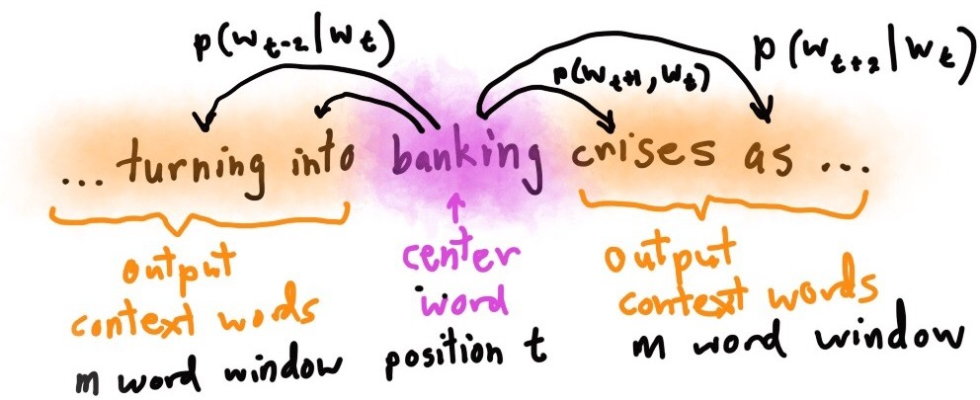
Skip-gram prediction

Slide 13
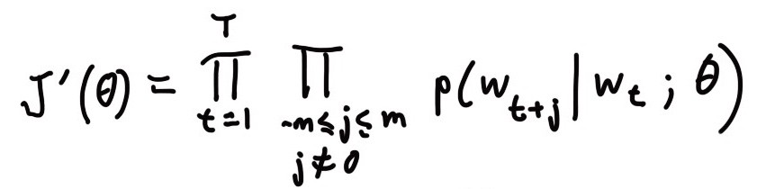
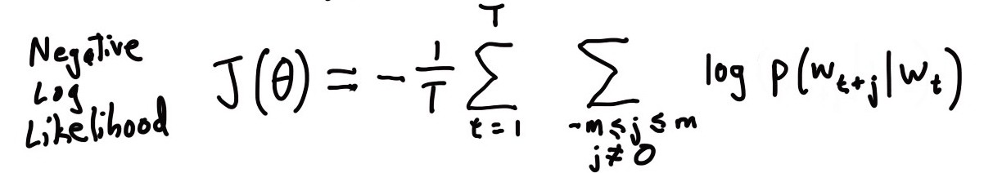
Details of word2vec
For each word t = 1 … T, predict surrounding words in a window of “radius” m of every word.
Objective function: Maximize the probability of any context word given the current center word:
Where θ represents all variables we will optimize

Slide 14
The objective function – details
Terminology: Loss function = cost function = objective function
Usual loss for probability distribution: Cross-entropy loss
With one-hot w_{t+j} target, the only term left is the negative log probability of the true class
More on this later…

Slide 15
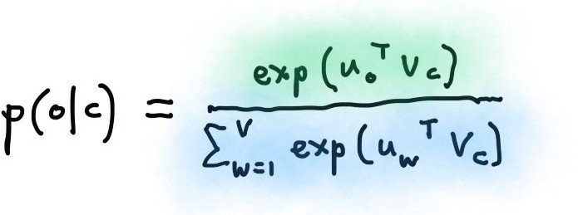
Details of Word2Vec
Predict surrounding words in a window of radius m of every word
^{p(w}t+j^{|w}t⁾
where o is the outside (or output) word index, c is the center word index, v_{c} and u_{o} are “center” and “outside” vectors of indices c and o
Softmax using word c to obtain probability of word o

Slide 16
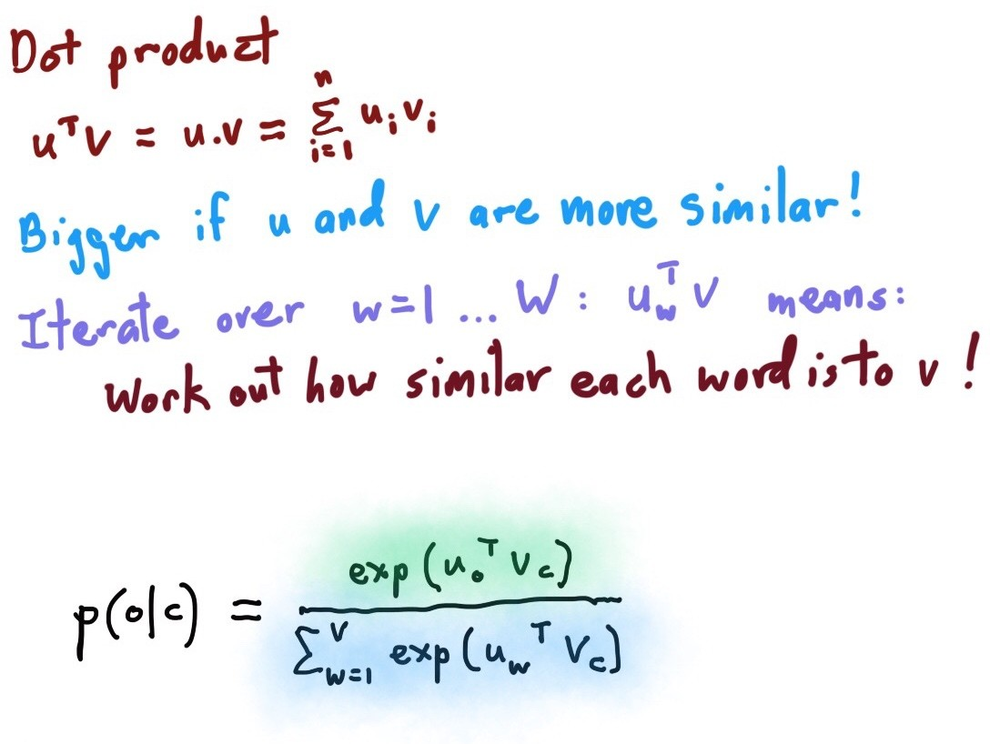
Dot products

Slide 17
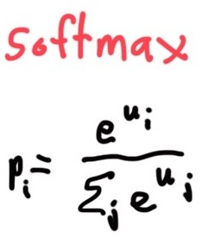




Softmax function: Standard map from ℝ^{V} to a probability distribution
Exponentiate to make positive
Normalize to give probability

Slide 18
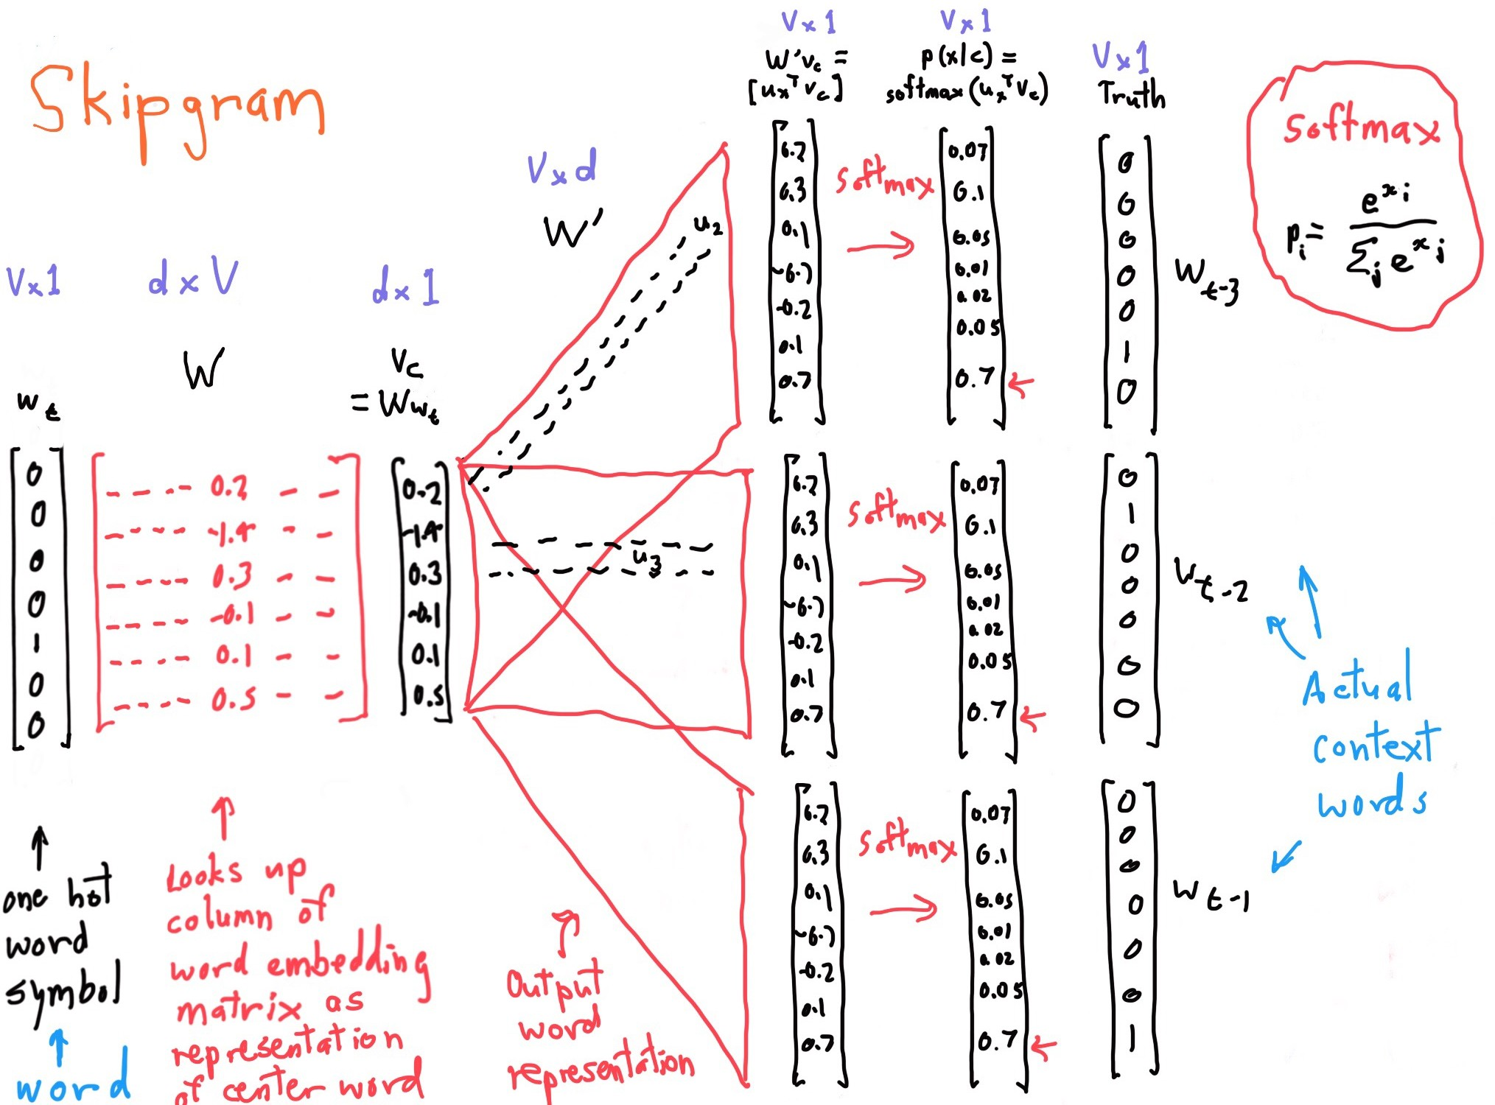
Skip gram model structure

Slide 19

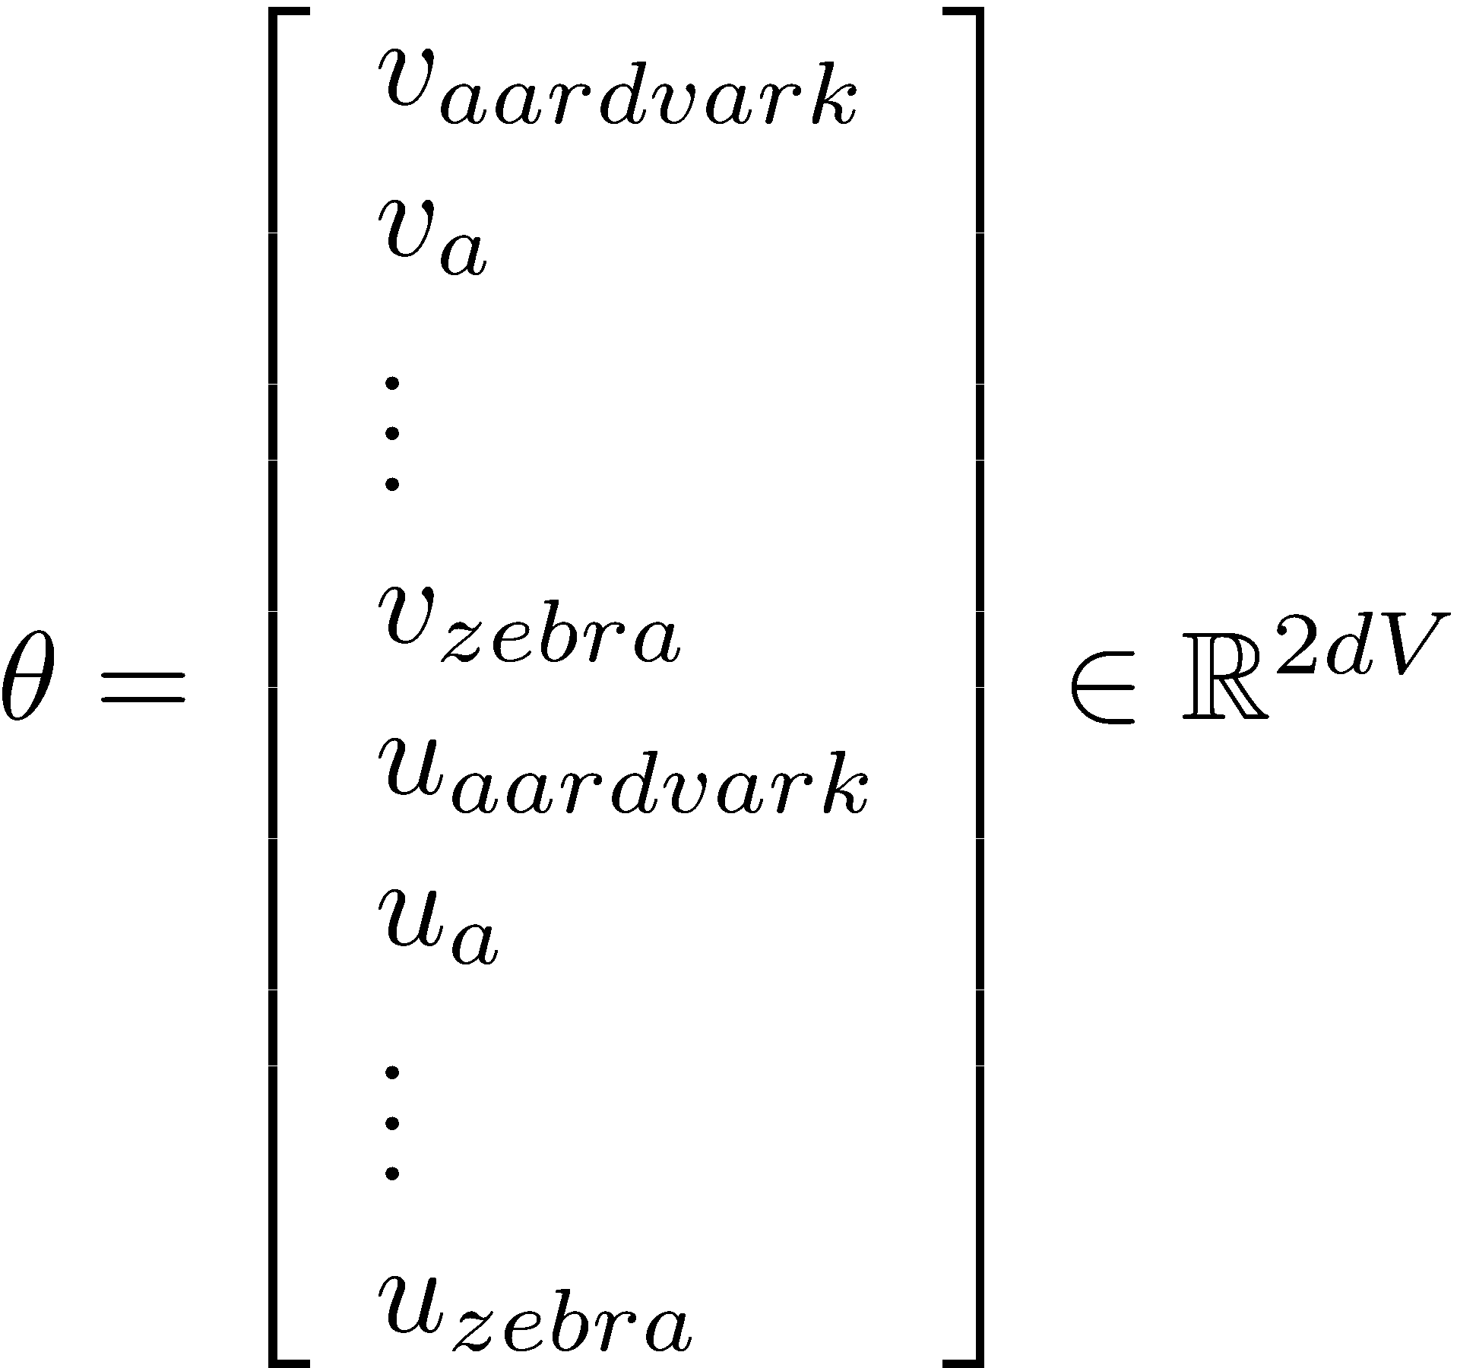
To train the model: Compute all vector gradients!
We often define the set of all parameters in a model in terms of one long vector
In our case with
d-dimensional vector and
V many words:
We then optimize these parameters
Note: Every word has two vectors! Makes it simpler!
s

Slide 20

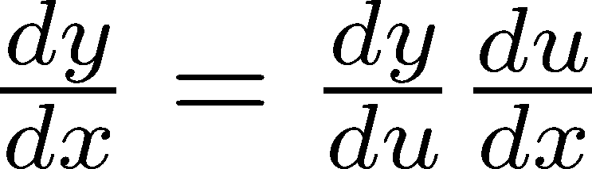
4. Derivations of gradient
Whiteboard – see video if you’re not in class ;)
The basic Lego piece
Useful basics:
If in doubt: write out with indices
Chain rule! If y = f(u) and u = g(x), i.e. y = f(g(x)), then:

Slide 21
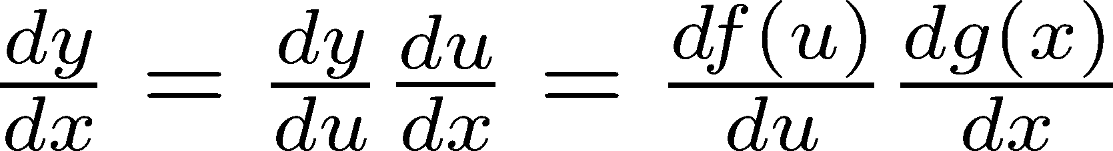
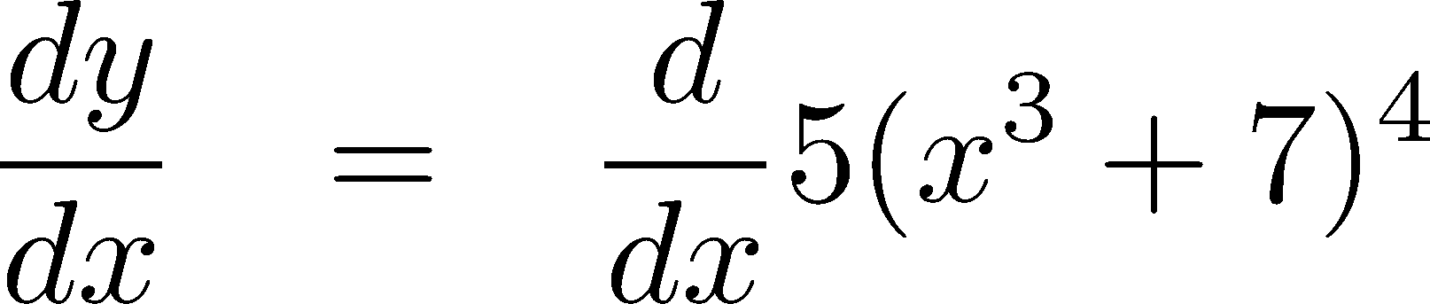
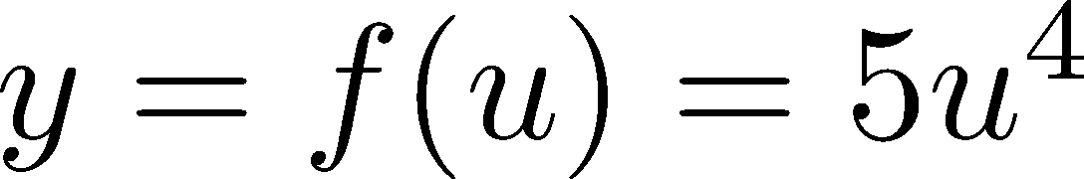
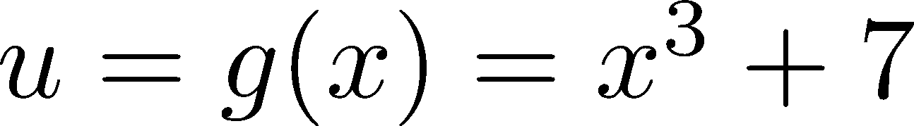
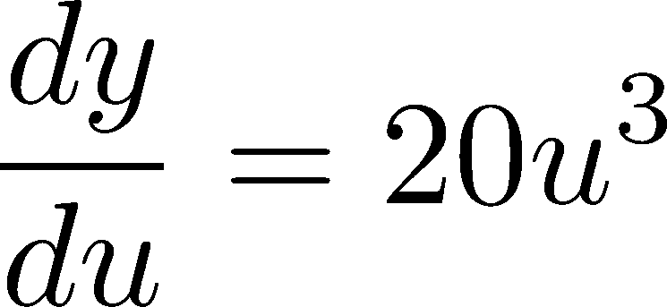
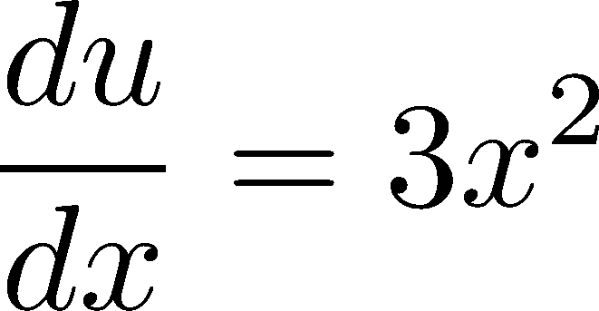
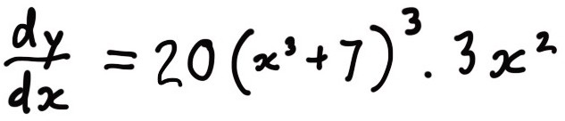
Chain Rule
Chain rule! If y = f(u) and u = g(x), i.e. y = f(g(x)), then:
Simple example:

Slide 22
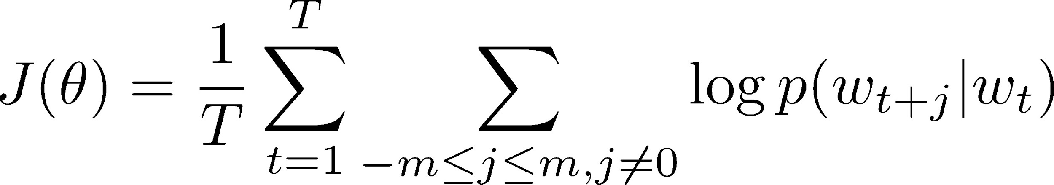
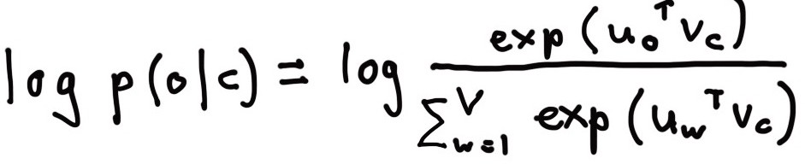
Interactive Whiteboard Session!
Let’s derive gradient for center word together
For one example window and one example outside word:
You then also also need the gradient for context words (it’s similar; left for homework). That’s all of the paramets θ here.

Slide 23
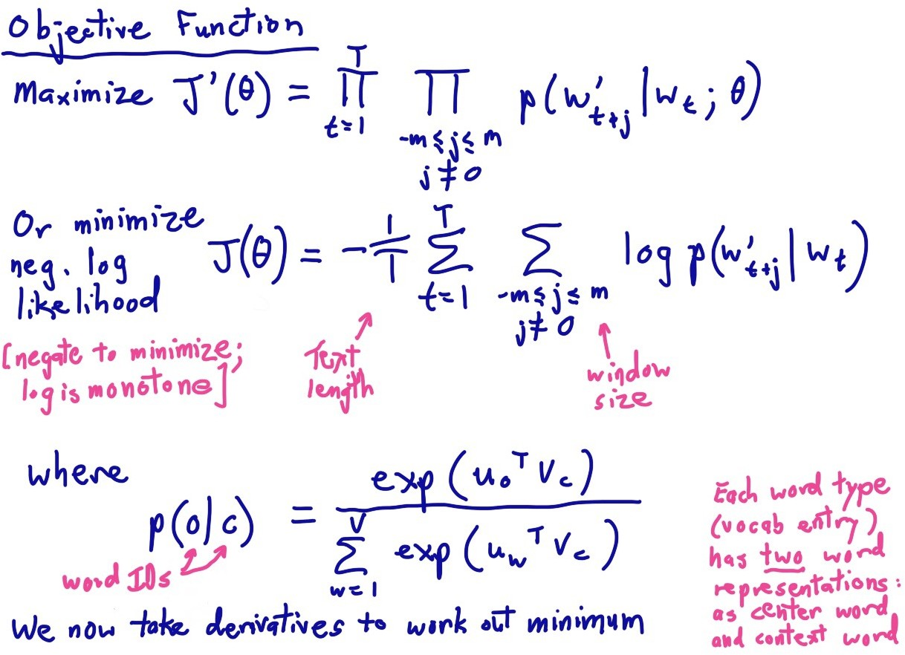

Slide 24
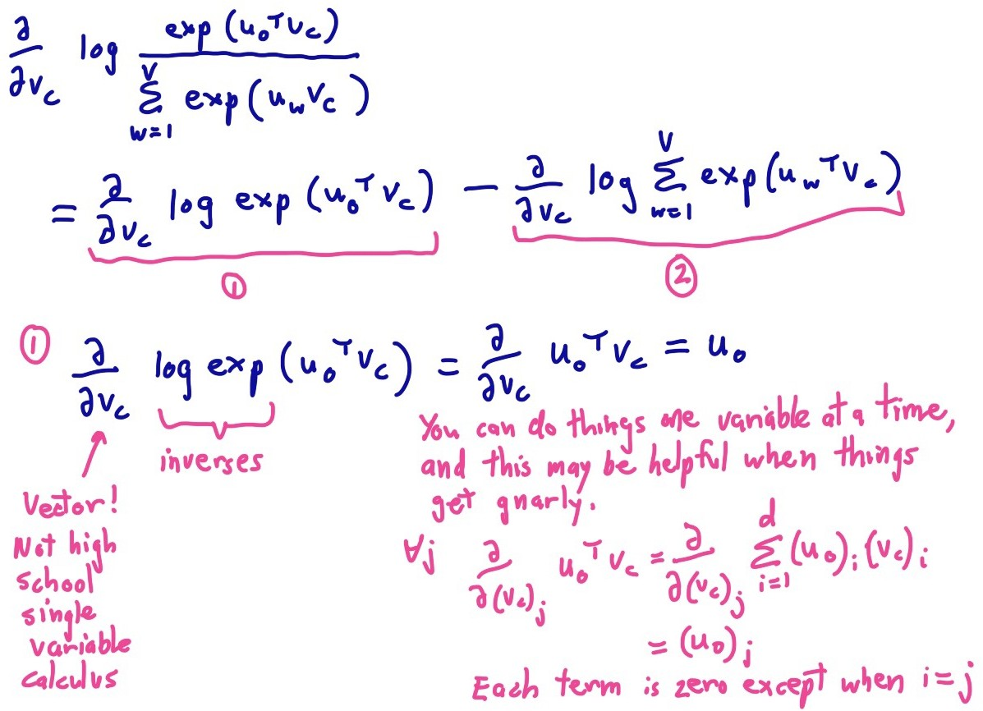

Slide 25
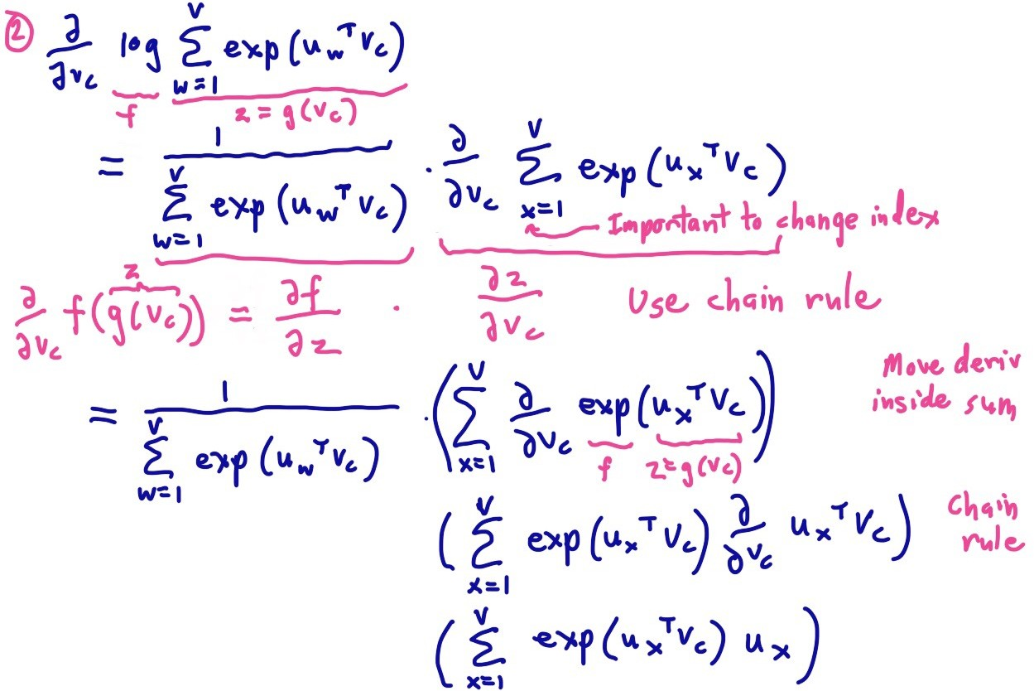

Slide 26
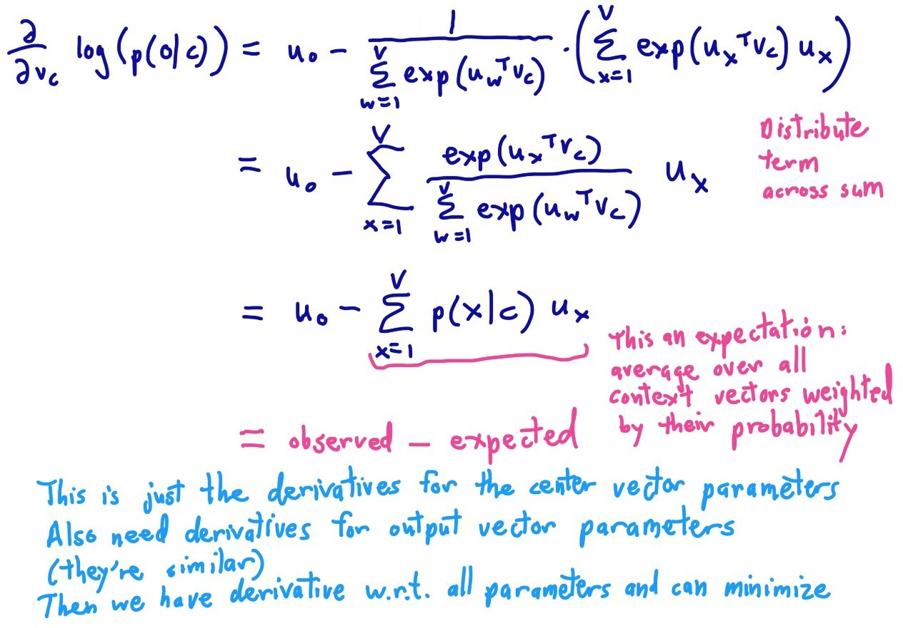

Slide 27
Calculating all gradients!
We went through gradient for each center vector v in a window
We also need gradients for outside vectors u
Derive at home!
Generally in each window we will compute updates for all parameters that are being used in that window.
For example, window size m = 1, sentence:
“We like learning a lot”
First window computes gradients for:
internal vector v_{like} and external vectors u_{We} and u_{learning}
Next window in that sentence?

Slide 28
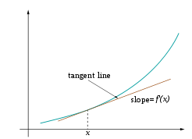
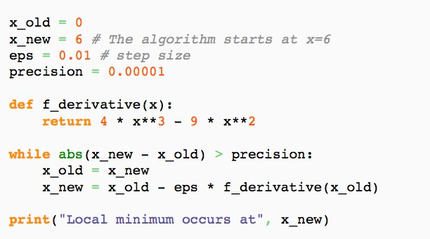
5. Cost/Objective functions
We will optimize (maximize or minimize) our objective/cost functions
For now: minimize à gradient descent
Find a local minimum of the function
f(x) = x⁴−3x³+2, with derivative f'(x) = 4x³−9x²
Subtracting a fraction of the gradient moves you towards the
minimum!

Slide 29
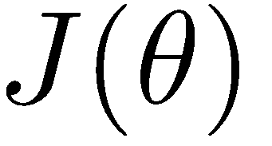
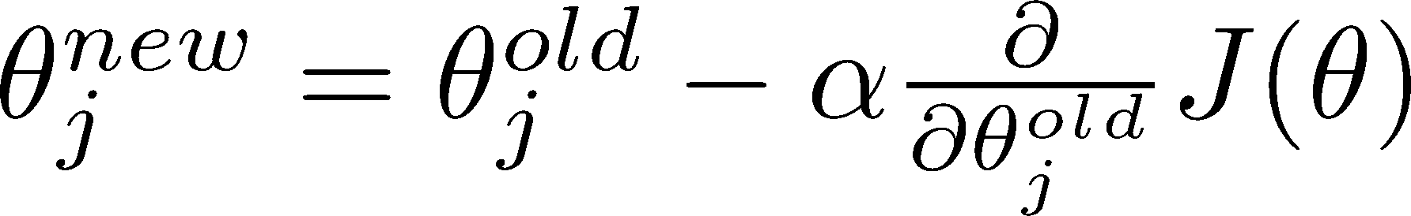
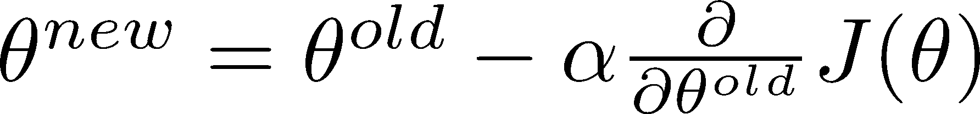
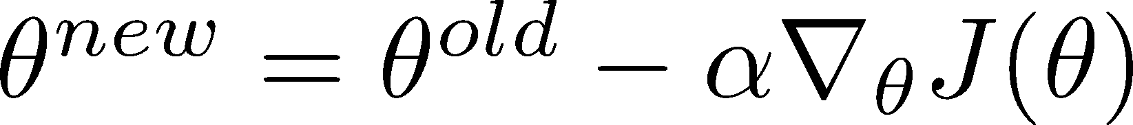
Gradient Descent
To minimize over the full batch (the entire training data) would require us to compute gradients for all windows
Updates would be for each element of θ :
With step size α
In matrix notation for all parameters:

Slide 30

Vanilla Gradient Descent Code

Slide 31
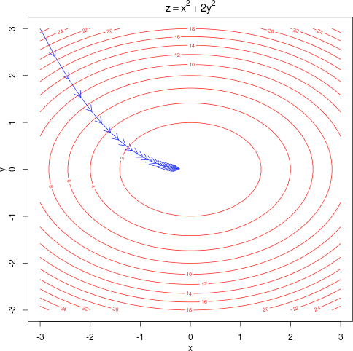
Intuition
For a simple convex function over two parameters.
Contour lines show levels of objective function

Slide 32
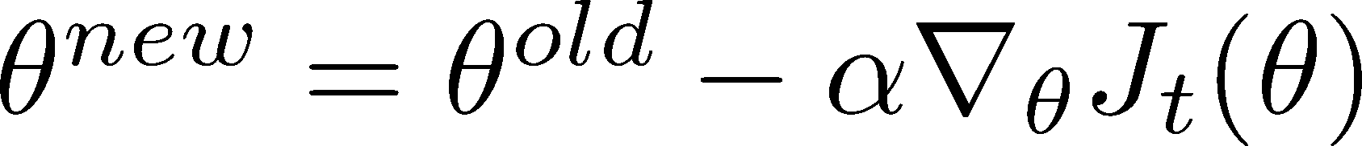
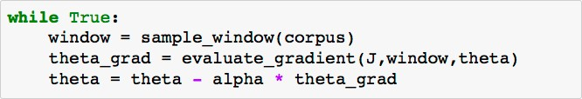
Stochastic Gradient Descent
But Corpus may have 40B tokens and windows
You would wait a very long time before making a single update!
Very bad idea for pretty much all neural nets!
Instead: We will update parameters after each window t
à Stochastic gradient descent (SGD)

